Slide 1
ERIN BARTHOLOMEW
DELFT UNIVERSITY OF TECHNOLOGY
ROBUST DECISION SUPPORT METHODS
A COMPARATIVE ANALYSIS

Slide 2
Introduction
Research Definition
Chapters 1 and 2
Review of Concepts
Chapter 3
Method
Definition of Comparisons
Chapter 9
Method and Problem Development
Chapters 4-8
Analysis
Method Application
MORDM
MORO
Multi-scenario MORDM
Results
Chapter 10
MORDM
Multi-scenario MORDM
MORO
Comparisons
Chapter 11
Discussion and Future Work
Chapters 12 and 13

Slide 3
RDM
MORDM
1. Model Specification, following XLRM framework
1. Model Specification
2. Policy Alternative Determination, manually or through algorithms
2. Policy Alternative Determination, using an MOEA with a single
reference scenario
3. Computational Experimentation, often using exploratory modeling software
3. Computational experimentation through uncertainty analysis
4. Scenario Discovery, using an algorithm like PRIM or CART
4. Scenario Discovery
Multi Scenario-MORDM
MORO
1. Model Specification
1. Model Specification
2a. MORDM to determine weaknesses in identified policies through Scenario Discovery
2. Policy Alternative Determination, using an MOEA with robustness considerations and multiple scenarios
2b. Reference Scenario Selection
2b. Policy Alternative Determination
3. Computational experimentation through uncertainty analysis
2b. Policy Alternative Determinationç
2c. Policy Alternative Determination
3. Computational Experimentation
4. Scenario Discovery
3. Computational Experimentation
3. Computational Experimentation, through uncertainty analysis
3. Computational Experimentation
3. Computational Experimentation
4. Scenario Discovery

Slide 4
1. Model Specification
1. Model Specification
1. Model Specification
2a. MORDM to determine weaknesses in identified policies through Scenario Discovery
2. Policy Alternative Determination, using an MOEA with a single
reference scenario
2. Policy Alternative Determination, using an MOEA with robustness considerations and multiple scenarios
2b. Reference Scenario Selection
2b. Policy Alternative Determination
2b. Policy Alternative Determinationç
2c. Policy Alternative Determination
3. Uncertainty Analysis
3. Uncertainty Analysis
3. Computational Experimentation
3. Computational Experimentation
3. Uncertainty Analysis
4. Scenario Discovery
4. Scenario Discovery
3. Computational Experimentation
3. Computational Experimentation
4. Scenario Discovery
Multi Scenario-MORDM
MORDM
1. Model Specification
MORO
1. Model Specification
1. Model Specification
2a. MORDM to determine weaknesses in identified policies through Scenario Discovery
2. Policy Alternative Determination, using an MOEA with a single
reference scenario
2. Policy Alternative Determination, using an MOEA with robustness considerations and multiple scenarios
2b. Reference Scenario Selection
2b. Policy Alternative Determination
2b. Policy Alternative Determination
2c. Policy Alternative Determination
3. Uncertainty Analysis
3. Uncertainty Analysis
3. Computational Experimentation
3. Computational Experimentation
4. Scenario Discovery
3. Uncertainty Analysis
4. Scenario Discovery
3. Computational Experimentation
3. Computational Experimentation
4. Scenario Discovery

Slide 5
1. Model Specification
2. Policy Alternative Determination
3. Uncertainty Analysis
4. Scenario Discovery
1. Model Specification
1. Model Specification
2. Policy Alternative Determination
2. Policy Alternative Determination
3. Uncertainty Analysis
3. Uncertainty Analysis
4. Scenario Discovery
4. Scenario Discovery
1. Model Specification
1. Model Specification
2. Policy Alternative Determination
2. Policy Alternative Determination
3. Uncertainty Analysis
3. Uncertainty Analysis
4. Scenario Discovery
4. Scenario Discovery

Slide 6
DPS
LT DPS
Inter
MORDM
Multi
MORO

Slide 7
Policy Levers
(L)
External Uncertainties
(X)
System Relationships
(R)
Outcomes of Interest
(M)

Slide 8


Natural Pollution Inflows
Anthropogenic Pollution
Natural
Pollution
Outflows

Slide 9
Convergences

Slide 10
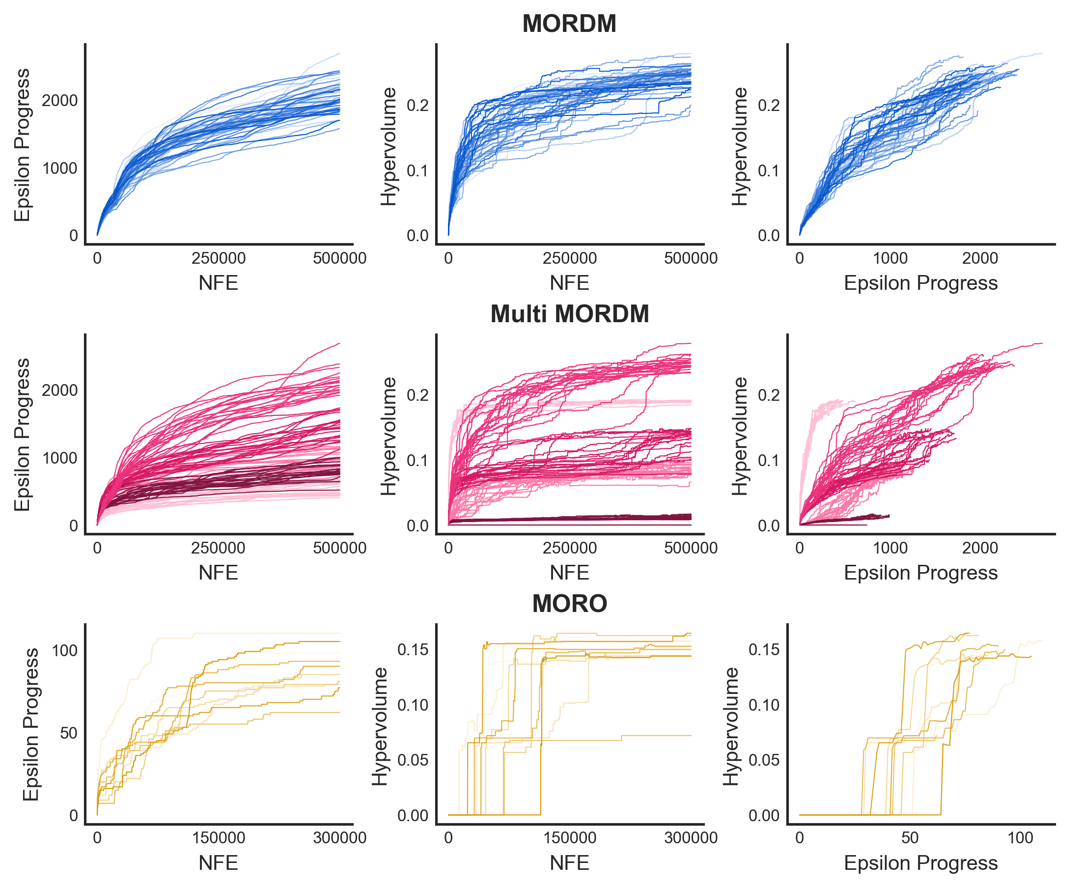
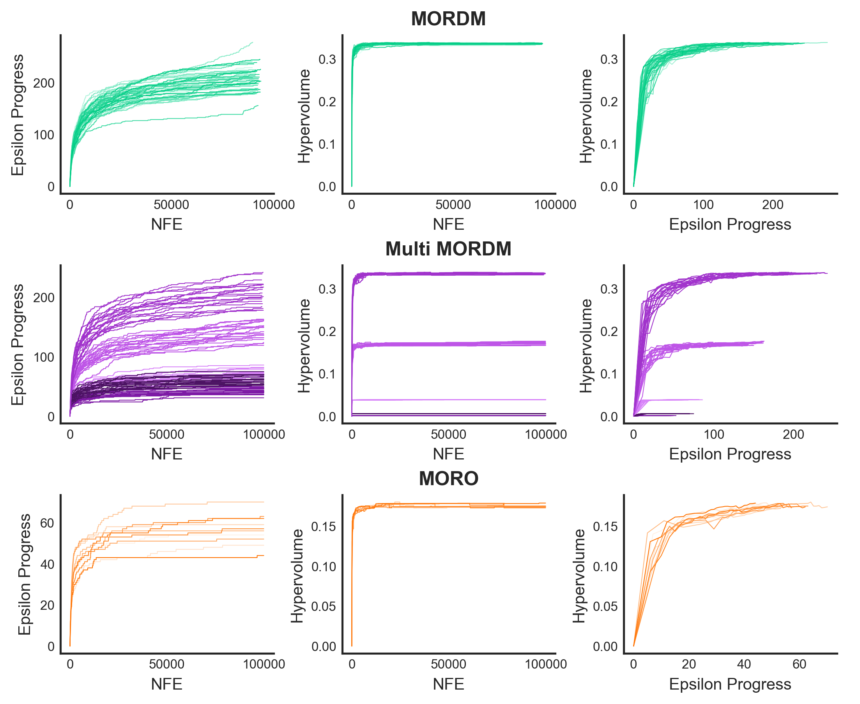
Intertemporal
Planned Adaptive DPS

Slide 11
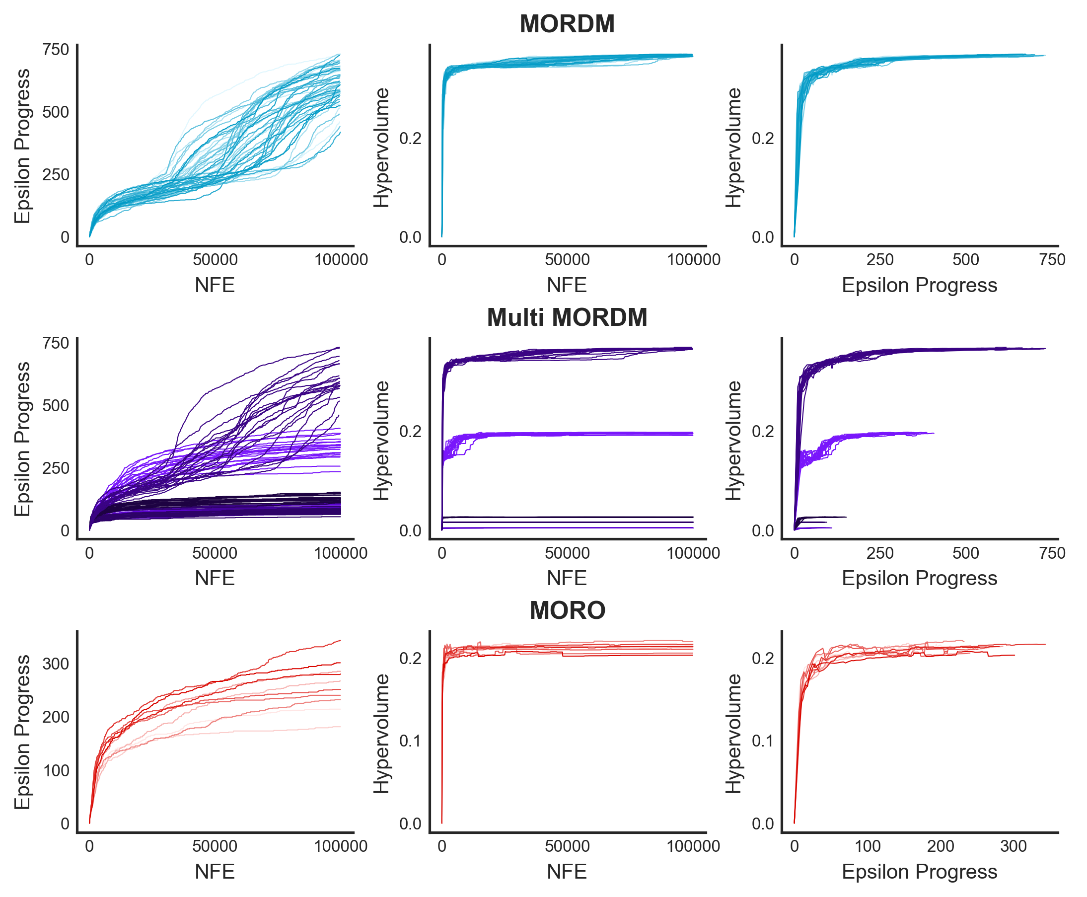
Planned Adaptive DPS
Direct Policy Search

Slide 12
Intertemporal
Method |  | Size of Front
MORDM |  | 90
Multi-Scenario MORDM | 1 | 34
 | 2 | 36
 | 3 | 71
 | 4 | 59
 | Base | 91
MORO |  | 7
Planned Adaptive DPS
Method |  | Size of Front
MORDM |  | 48
Multi-Scenario MORDM | 1 | 28
 | 2 | 37
 | 3 | 5
 | 4 | 7
 | Base | 36
MORO |  | 6
Direct Policy Search
Method |  | Size of Front
MORDM |  | 110
Multi-Scenario MORDM | 1 | 60
 | 2 | 11
 | 3 | 8
 | 4 | 15
 | Base | 115
MORO |  | 22
 | Small Epsilon Values | Big Epsilon Values
Epsilon Values | [0.01, 0.01, 0.001, 0.001] | [0.1, 0.1, 0.01, 0.01]
Size of non-dominated set of policy alternatives | 683 | 110

Slide 13
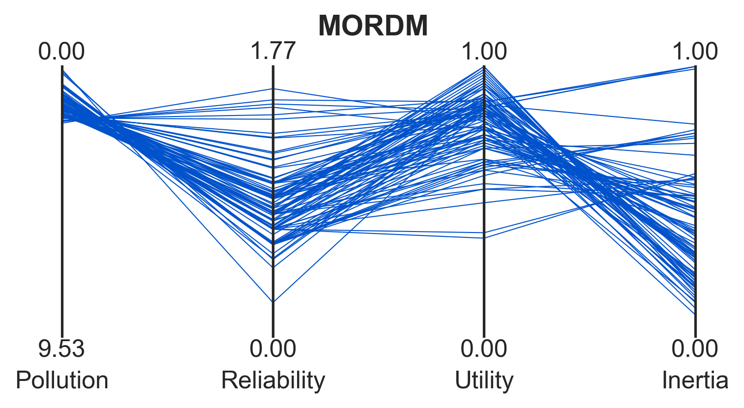
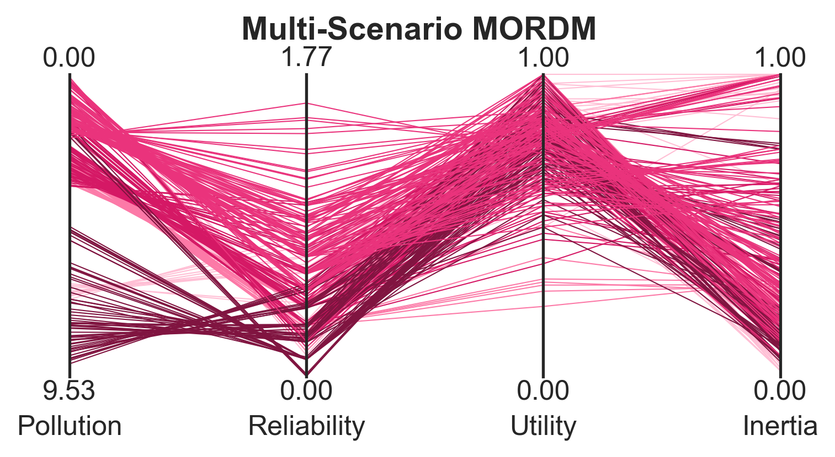
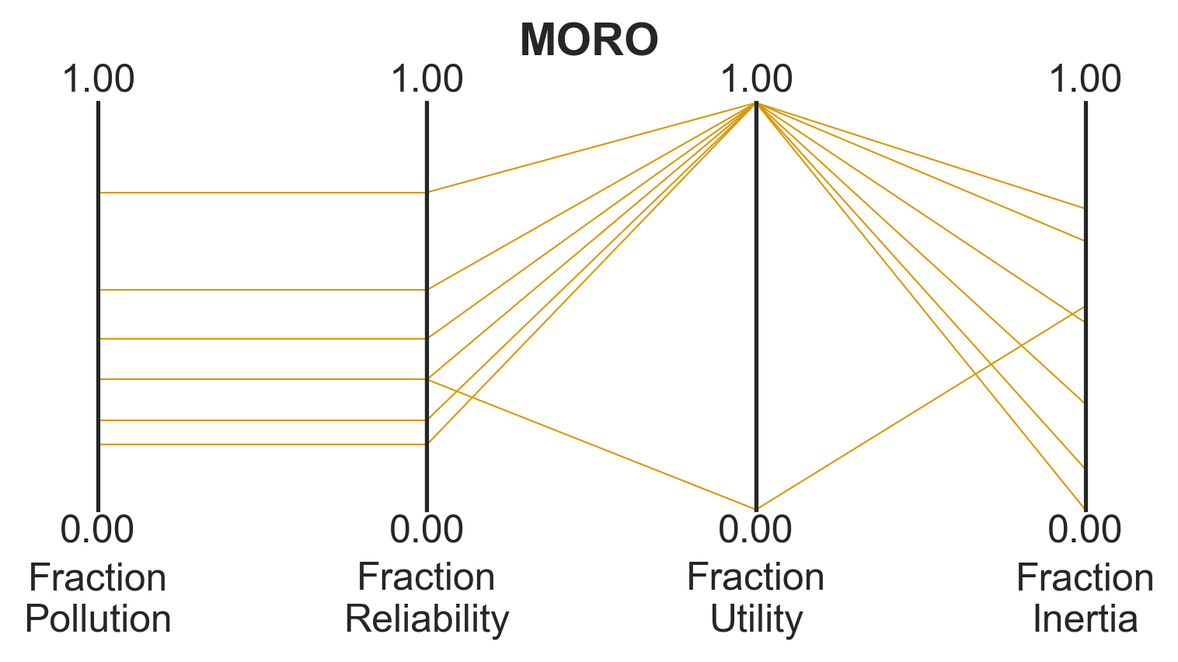
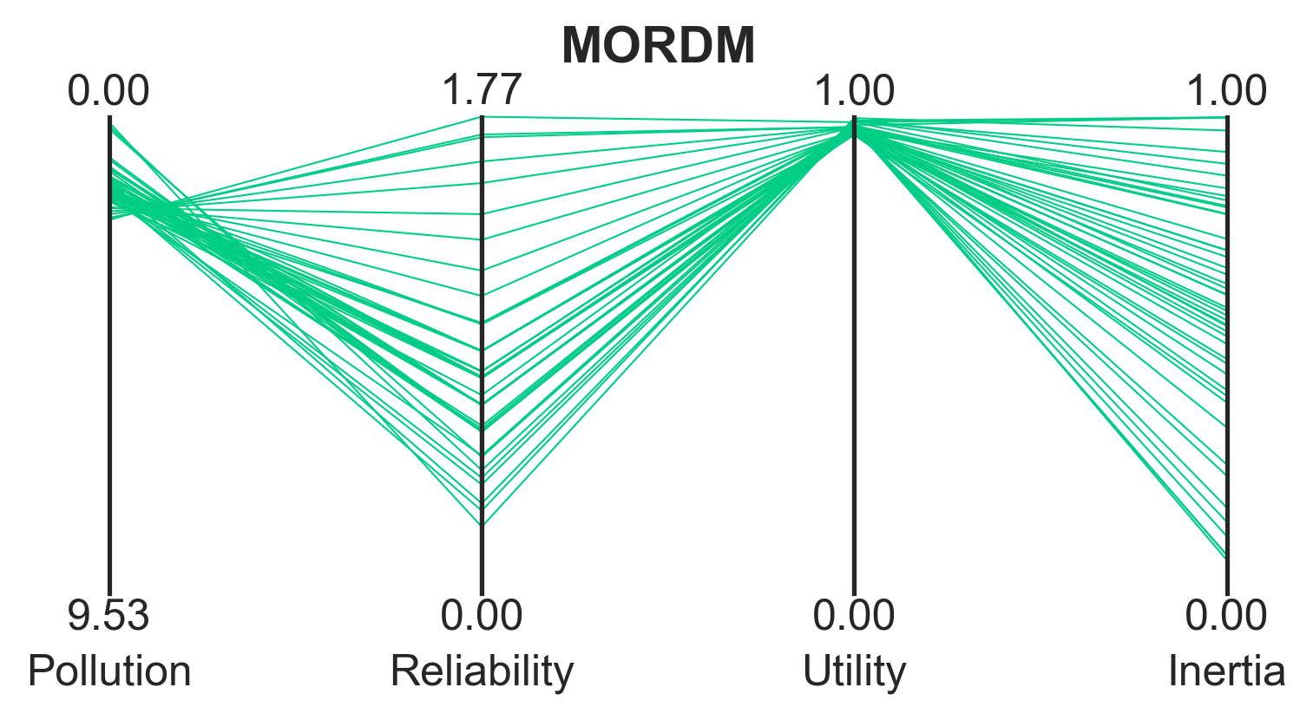
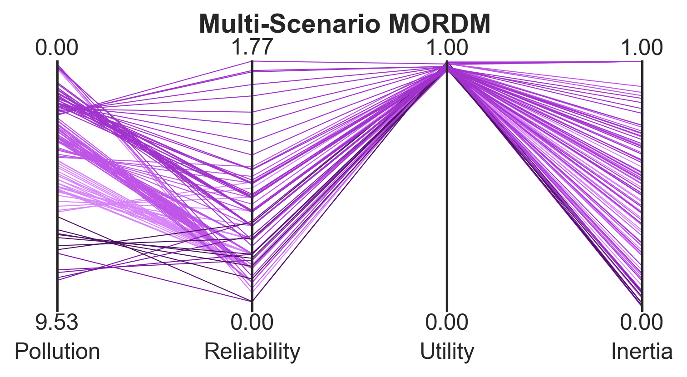
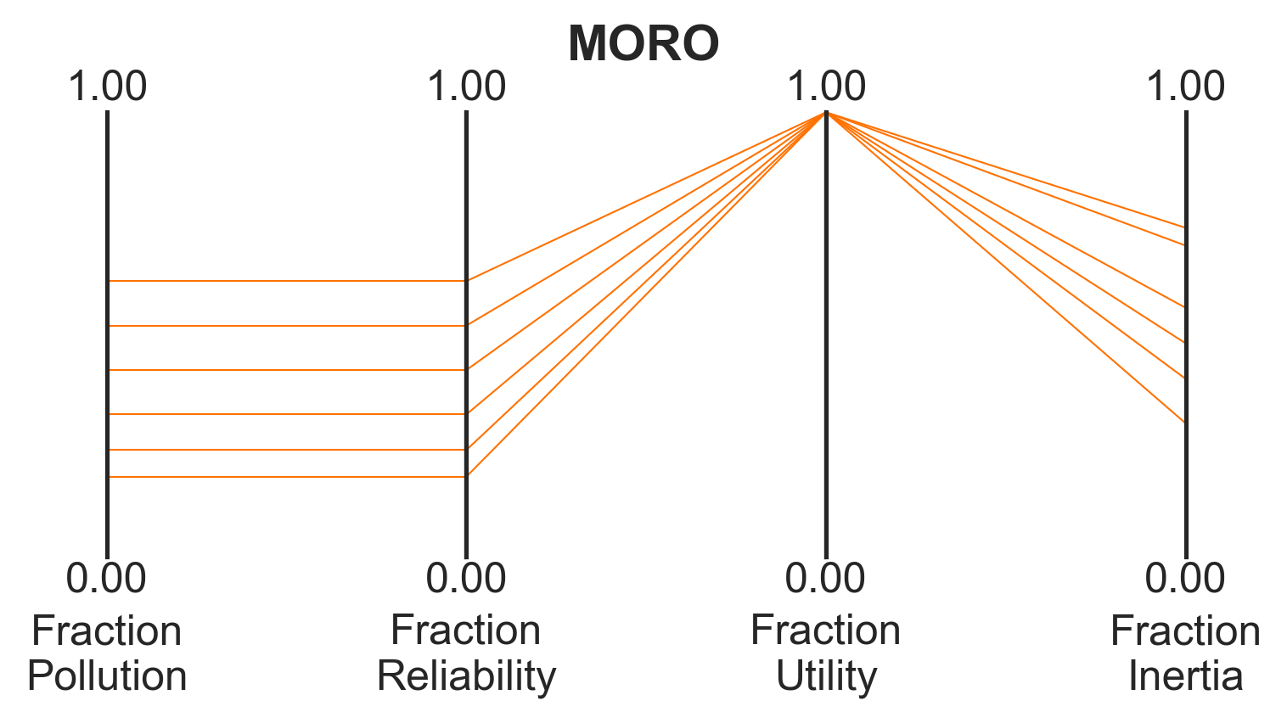
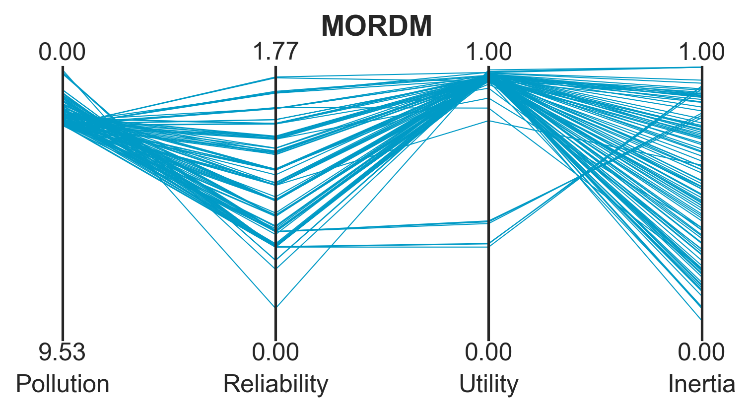
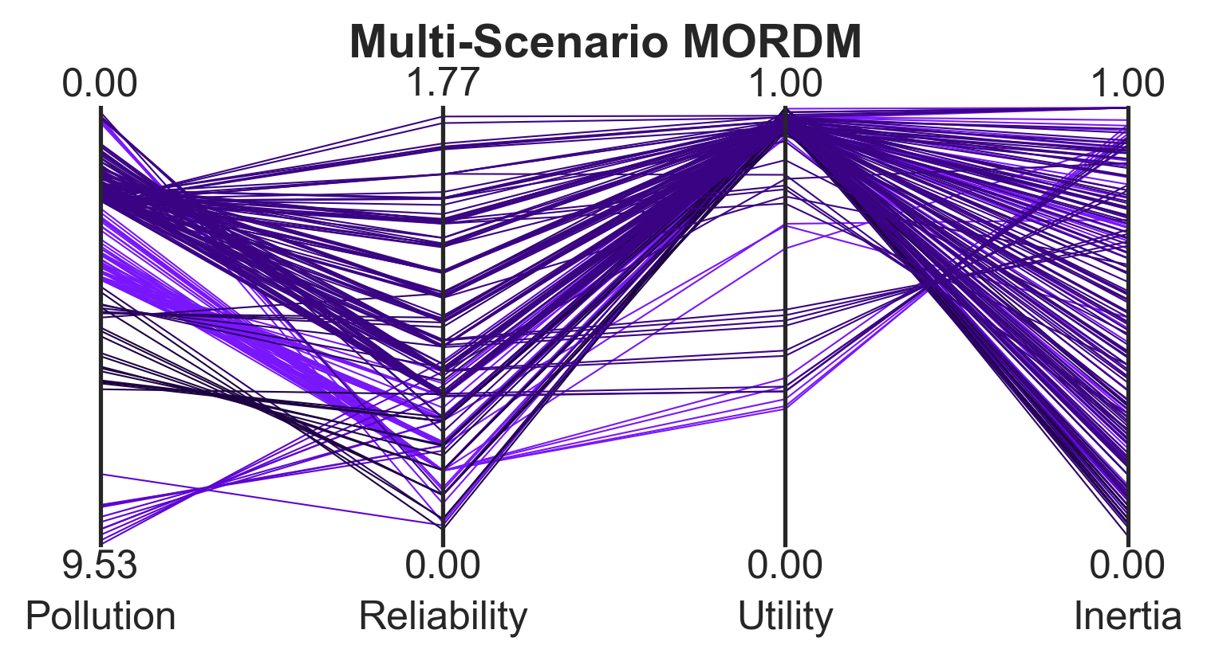
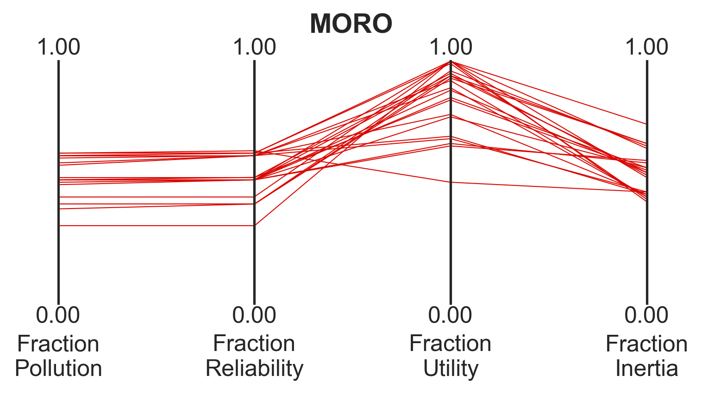
Outcomes of policy alternatives after search
Intertemporal
Planned Adaptive DPS
DPS

Slide 14
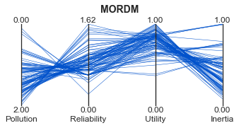
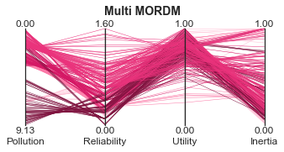
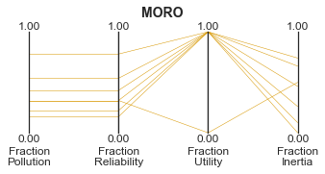
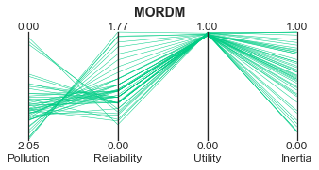
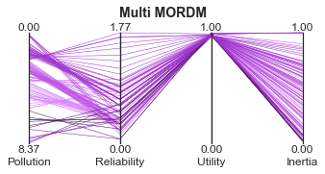
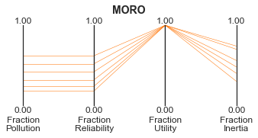
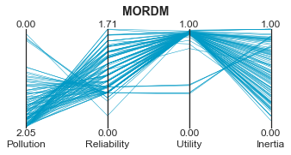
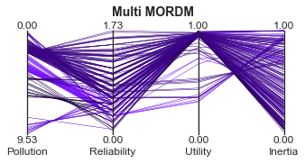
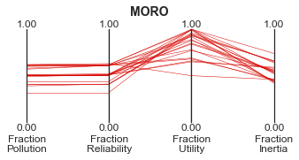
Outcomes of policy alternatives after search
Intertemporal
Planned Adaptive DPS
DPS

Slide 15
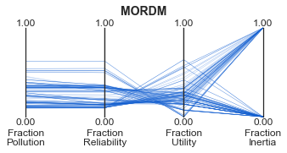
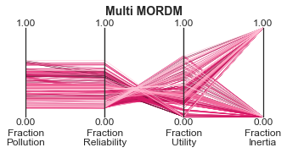
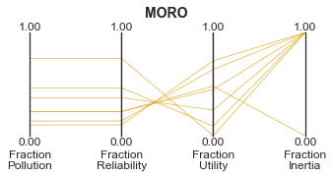
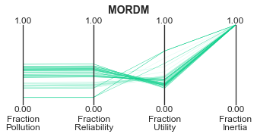
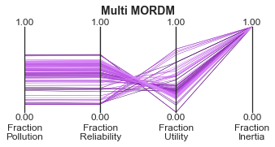
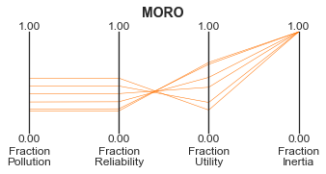
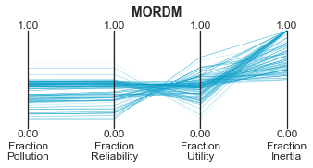
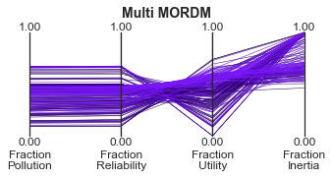
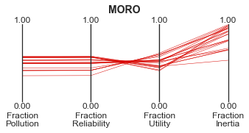
Robust values after exploration
Intertemporal
Planned Adaptive DPS
DPS

Slide 16
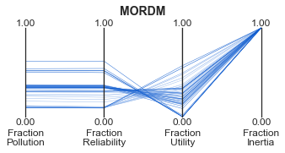
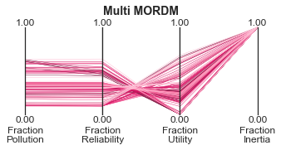
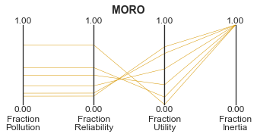
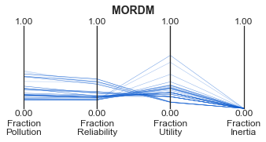
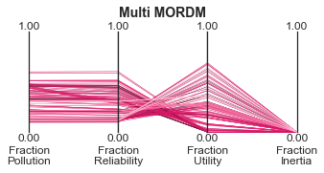
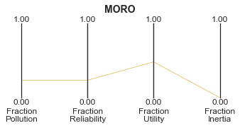
MORO – isolating high and low inertia
High Inertia-Based Robustness
Low Inertia-Based Robustness

Slide 17
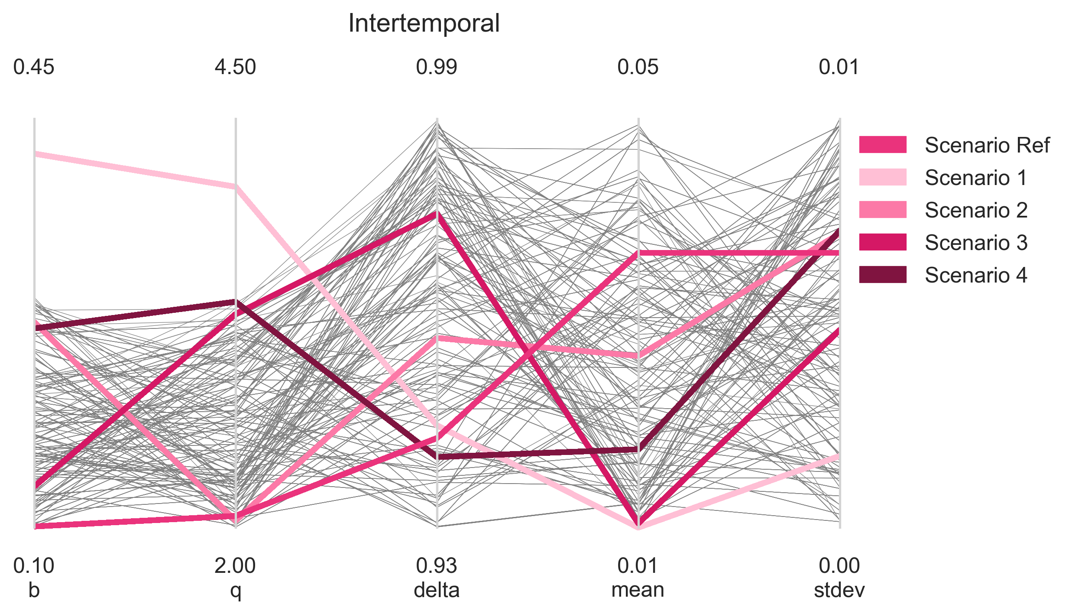
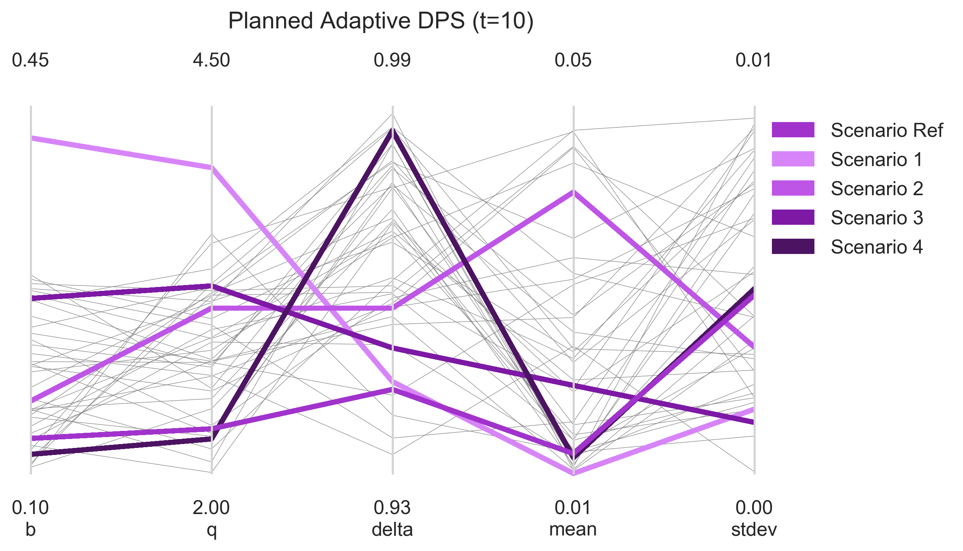
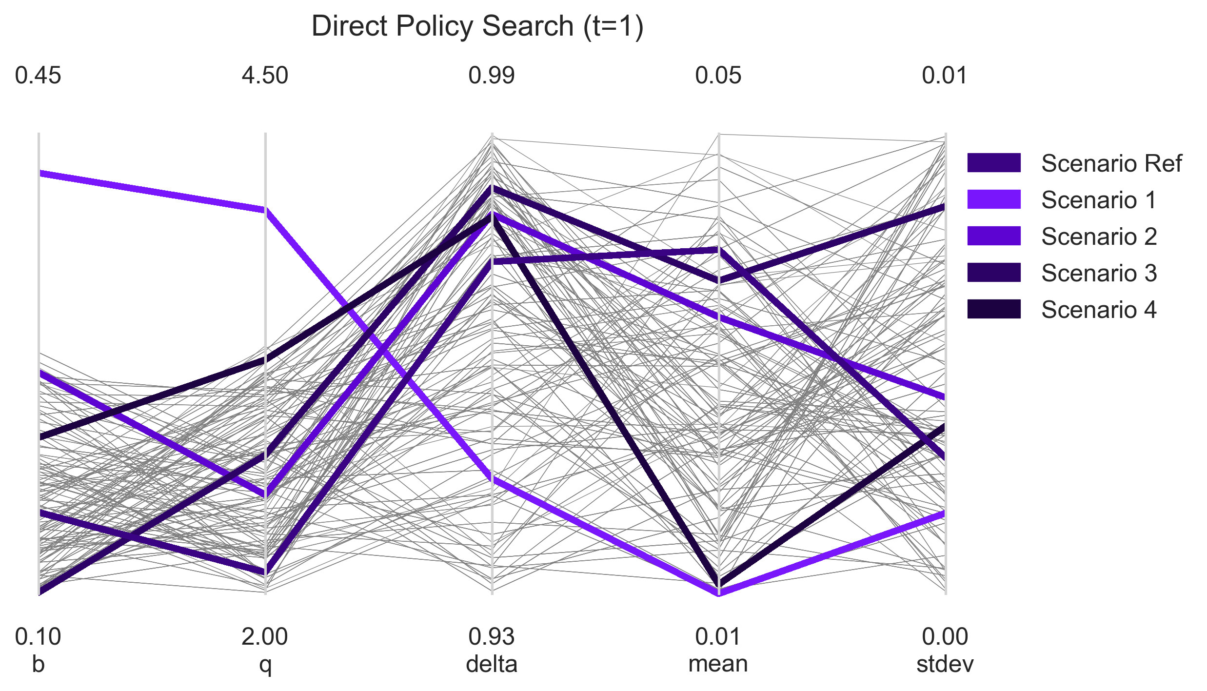

Slide 18
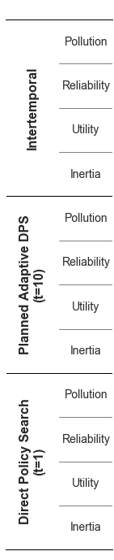
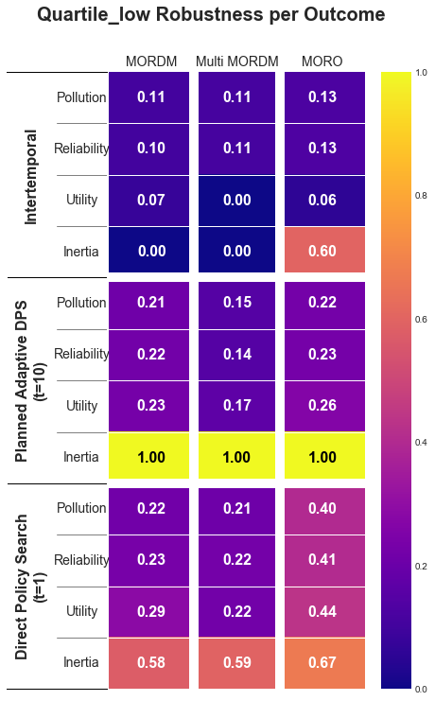
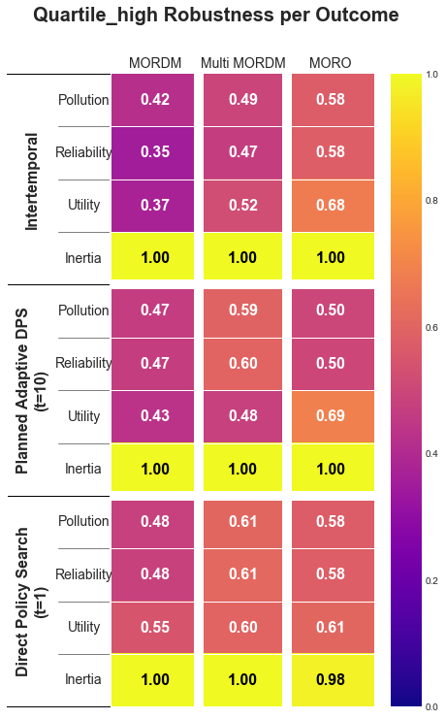
10th Percentile Robustness
90th Percentile Robustness

Slide 19
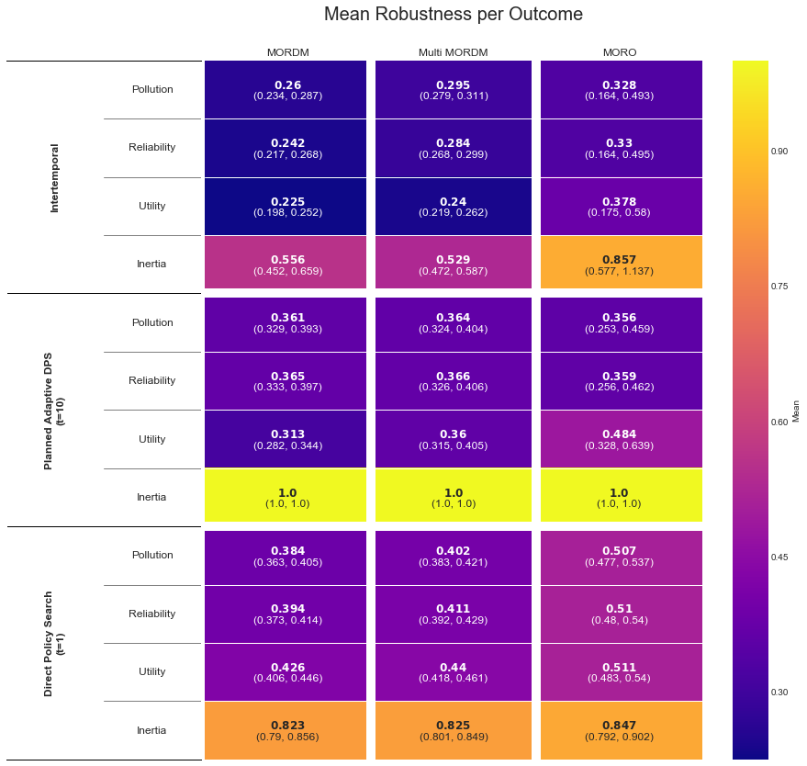
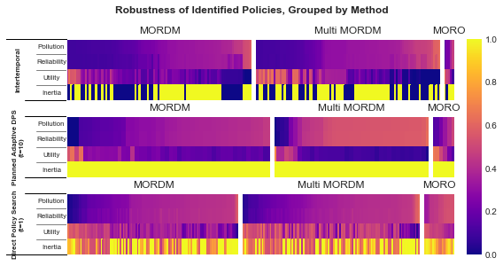
1.0
0.5
0

Slide 20
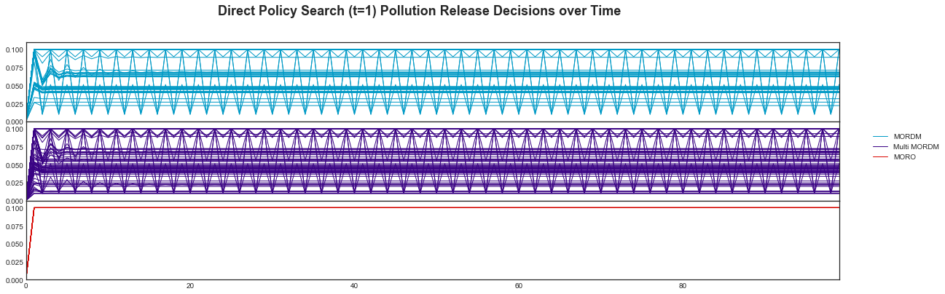
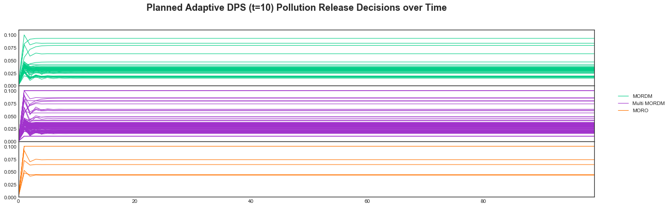
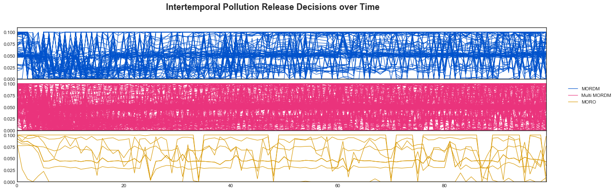
DPS (t=1) Pollution Release Decisions over Time
MORDM
Multi MORDM
MORO
Planned Adaptive DPS (t=10) Pollution Release Decisions over Time
MORDM
Multi MORDM
MORO
Intertemporal Pollution Release Decisions over Time
MORDM
Multi MORDM
MORO

Slide 22
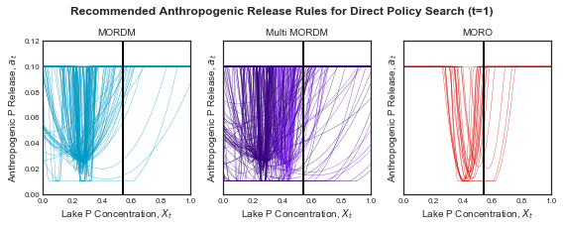
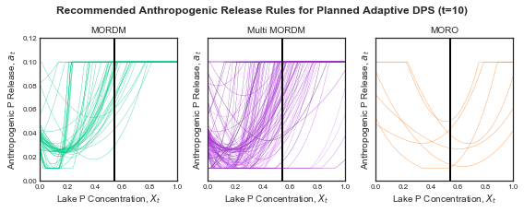

Slide 23
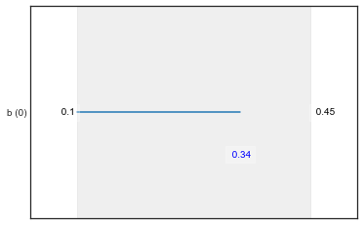


Intertemporal
Planned Adaptive DPS (t=10)
DPS (t=1)

Slide 24




Slide 25




Slide 26




Slide 27






Intertemporal

Slide 28






Planned Adaptive DPS (t=10)

Slide 29






Direct Policy Search (t=1)

Slide 30



Size of Pareto Front for each Search Repetition
Hypervolume of Pareto Front for each
Search Repetition
Pareto Front Size vs Hypervolume for each Search Repetition
Intertemporal
Planned Adaptive
DPS

Slide 31



Size of Pareto Front for each Search Repetition per Reference Scenario
Intertemporal
Planned Adaptive
DPS
Hypervolume of Pareto Front for each Search Repetition per Reference Scenario
Intertemporal
Planned Adaptive
DPS
Pareto Front Size vs Hypervolume for each Search Repetition per Reference Scenario
Intertemporal
Planned Adaptive
DPS

Slide 32



Size of Pareto Front for each Search Repetition
Hypervolume of Pareto Front for each
Search Repetition
Pareto Front Size vs Hypervolume for each Search Repetition
Intertemporal
Planned Adaptive
DPS

